Slide 1
Deep Reinforcement Learning
Amos Azaria

Slide 2
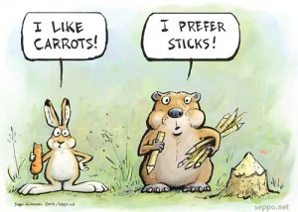
Reinforcement Learning
Important: The reward depends not only on the action, but also on the state of the environment!
Carrot vs. stick
Good dog / bad dog
Important2: The action changes the environment, otherwise this would have been a regular supervised learning problem.
Environment
Action
Reward
Agent
Notes:
A smart dog may learn that it is better off if it doesn't sit the first time it is told, because then the training sessions become longer and it is expected to gain more rewards!

Slide 3
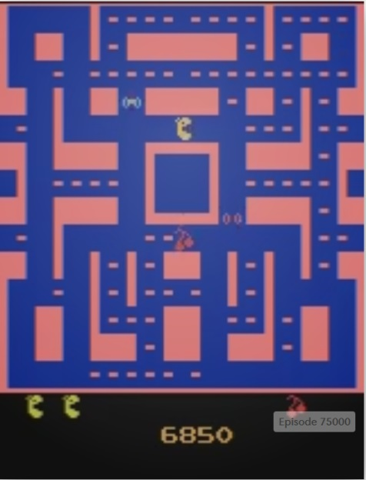
OpenAI Gym
An open source environment for allowing autonomous agents to play games.
Has very simple games (with text "graphics"), and more sophisticated games, such as Pacman and Doom.
Accessed using python.
pip install gym

Slide 4

Playing FrozenLake-v0
import gym
env = gym.make('FrozenLake-v0')
env.reset()
env.render()
move=getch() #sys.stdin.read(1) #input()
while move.isdigit():
dig_move = int(move)
if (dig_move < env.action_space.n):
env.step(dig_move)
env.render()
move=getch() #sys.stdin.read(1) #input()
Code for getch can be found at: http://stackoverflow.com/questions/510357/python-read-a-single-character-from-the-user

Slide 5
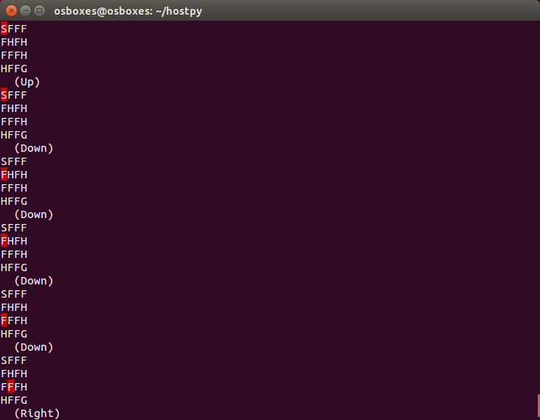
Playing Example:

Slide 6
MDP: (S,A,R,T)
S = states. The possible states of the world. Some states may be termination states. In the FrozenLake game, there are 4x4=16 states. 5 of which are termination (4 H and 1 G)
A = actions. The actions which the agent can take. In the FrozenLake game, there are 4 actions (left, right, up and down).
R = reward function. Usually tied to a specific state (R(s)) or state, action (R(s,a)). In the FrozenLake game, if the agent gets to the goal it receives 1 point, and if it gets to a hole, it receives 0 points. Future rewards are assumed to be discounted (exponentially) with a discount factor (γ).
T = transition function (T(s,a,s')). The probability that the agent will arrive at state s' given that it was in state s and took action a.

Slide 7
Discount factor
We assume some discount factor γ on future rewards.
For example, if γ=0.8, and the agent receives a reward of 2 this turn, 5 next turn, and 25 the following turn.
The total value for the agent will be 2 + γ(5 + γ25) = 2 + 0.8(5 + 20) = 22

Slide 8
Model-Free MDP Reinforcement Learning Assumptions
We assume that we are given the exact state (in a different model called Partially Observed MDP (POMDP) the agent is only given an observation, and is not given the exact state)
We assume a model-free learning, that is, we do not have any information on the transition state, or the reward function. (Models assuming (some) information or learning it directly are called model-based reinforcement learning or planning).
We know all actions we can take.

Slide 9
Q-values
We define a Q_{π}-value of a (state, action) pair, to be the expected utility / return for an agent at state s taking action a (and acting under policy pi).
For example, if at state s taking action a will result in a reward of 5 and will take the agent to a termination state, Q _{π}(s,a) = 5

Slide 10

Suppose we Had All Exact optimal Q_{π*}-values? (assuming an optimal π*)
The policy for the agent would be simple: always follow the action which gives the highest Q-value.
That is, take action:

Slide 11
Q-Learning (cont.)
Suppose we started at state s, took action a, received reward r, and arrived at state s' (≠s).
[Assume that when taking action a at state s, we always arrive at state s', that is T(s,a,s')=1.]
Suppose that we have the exact optimal Q-values of all state-action pairs except for s and a.
[Further assume that we always take the action that maximizes the Q(s,a).]
What would be Q(s,a)?
Q(s,a) = r + γmax_{a'}Q(s',a')

Slide 12
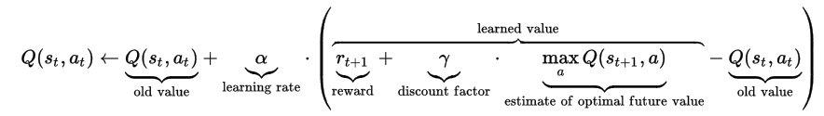
Q-Learning (cont.)
After performing an action, receiving the reward, and observing the new state, the Q-Learner updates its Q values.
This update is done using a learning rate, α (similar to SGD).
Q-Learner adds the delta between the old value and the expected new value.
This is what we get if we perform gradient descent, and define the loss as ((r + γmax_{a'}Q(s',a')) – Q(s,a))², while referring to Q(s,a) as a weight (W_{sa}), and Q(s',a') as a constant. (The 2 is absorbed by the α).
Wikipedia

Slide 13
Exploration vs. Exploitation
However we aren't given the Q-values, so we need to learn them.
Exploration: taking an action which might be sub-optimal but might teach the agent something. E.g. going to a new restaurant.
Exploitation: exploiting the already learned policy from past actions, and taking the action which is best given past observations. E.g. going to the best restaurant I am familiar with.
We can remove exploration after the agent is deployed (or for testing its performance)
Why use exploitation at all during training? Why not just explore, won't we learn the most?
If we only explore we are less likely to reach "interesting" states (and learn them).

Slide 14
Q-Learning
A reinforcement learning (RL) algorithm that learns a 'Q' value for every (state, action) pair.
(Usually) chooses a random action with probability ε, and chooses the best action according to current 'Q' values with probability (1- ε).
It assumes that next time it will take the optimal action (according to its 'Q' values).

Slide 15
Q-Learner for FrozenRiver
epsilon = 0.1
gamma = 0.95
alpha = 0.1
Q = np.zeros ([env.observation_space.n,env.action_space.n])
for i in range(10000): #number of games
s = env.reset()
done = False
while not done: #until game over, or max number of steps
if random.random() < epsilon:
a = env.action_space.sample()
else:
a = np.argmax(Q[s,:])
s_n, r, done, _ = env.step(a)
Q[s,a] = Q[s,a] + alpha*(r + gamma * np.max(Q[s_n,:]) - Q[s,a])
s = s_n
Notes:
As a side note, SARSA would first pick the next action and only then update the previous Q value.

Slide 16

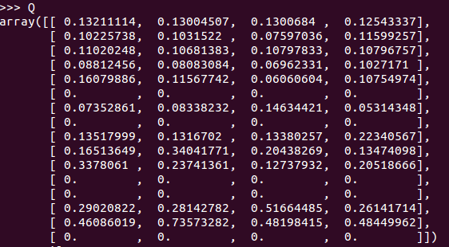
Obtained Q Values
Left Down Right Up
Notes:
For action meanings see: https://github.com/openai/gym/blob/master/gym/envs/toy_text/frozen_lake.py

Slide 17
What Happens When |S| is very large?
Suppose we had a network that given a state outputs the Q-value for each of the possible actions.
We would feed it the current state and calculate the Q-value for each of the possible actions.
We would choose the action which maximizes this Q-value.
But how would we obtain such a network?

Slide 18
Q-Learning With Large |S|
We Turn the Q-values into a Regression Problem.
That is, we try to predict the Q-values (for each action) given the state.
But where do we get the true Q-values from for training ("y_")?

Slide 19
Obtaining the "Real" Q-Value
Perform an action (one that maximizes the Q-value)
Get the reward (r),
Get the new state (s_n),
Calculate the Q-values of the new state (using the same network), for each of the actions. q_n, will denote the maximum Q (among all actions).
Now the "real" Q-value (for the previous state-action pair) is simply: r + γ * q_n
(the other Q-values for actions we didn't take remain unchanged)
Calculate loss etc.

Slide 20
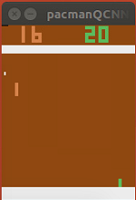
The Pong Game!
Huge state space (why?)
6 actions (not sure why…)
pip install gym[atari] (see https://github.com/openai/gym for additional dependencies)
Same code as before (for playing FrozenLake), the only difference is to replace:
env = gym.make('FrozenLake-v0')
with:
env = gym.make('Pong-v0')
The focus needs to be on the console for the game to work.

Slide 21
Random Player
import gym
import time
env = gym.make('Pong-v0')
env.reset()
for _ in range(1000):
env.render()
env.step(env.action_space.sample()) # random action
time.sleep(0.03)
Received approx. -20.3 points per game on average

Slide 22
The Network (Linear Regression)
env = gym.make('Pong-v0')
epsilon = 0.1
gamma = 0.999
state = tf.placeholder(tf.float32, shape=[1, 210, 160, 3])
state_vec = tf.reshape(state, [1, 210*160*3])
W1 = tf.Variable(tf.truncated_normal([210*160*3,env.action_space.n], stddev=1e-5))
b1 = tf.Variable(tf.constant(0.0, shape=[env.action_space.n]))
Q4actions = tf.matmul(state_vec,W1) + b1
Q_n = tf.placeholder(tf.float32, shape=[1, env.action_space.n])
loss = tf.sum(tf.pow(Q4actions - Q_n, 2))
update = tf.train.GradientDescentOptimizer(1e-10).minimize(loss)
Screen dimensions are 210x160, RGB
Only a single input at once for now (We usually have here 'None')

Slide 23
Training
sess = tf.Session()
sess.run(tf.global_variables_initializer())
for i in range(num_of_games):
env.reset()
s, _, done, _ = env.step(0) #first move doesn't matter anyway, just get the state
while not done:
all_Qs = sess.run(Q4actions, feed_dict={state:[s]})
if random.random() < epsilon:
next_action = env.action_space.sample()
else:
next_action = np.argmax(all_Qs)
s_n, r, done, _ = env.step(next_action)
Q_corrected = np.copy(all_Qs)
next_Q = sess.run(Q4actions, feed_dict={state:[s_n]})
Q_corrected[0][next_action] = r + gamma * np.max(next_Q)
sess.run(update, feed_dict={state:[s], Q_n: Q_corrected})
s = s_n #move to the next state

Slide 24
Results
Doesn't really work…
The state input is too large (210 x 160 x 3):
We can down-sample and use only a gray-scale get a (105 x 80 x 1).
We can further set the background to 0 and the foreground to 1.
Our model is too simple:
We need to go deeper!

Slide 25
Deep CNN Regression
We will convert the linear regression Q-Learner into a Deep CNN regression Q-Learner.
We will create 2 convolution layers, and 2 fully connected layers.
We keep previous frames (to preserve movement). So a state (for the CNN) is now composed of 4 previous states.

Slide 26
Additional improvements
We start playing randomly for the first X games.
The probability for random move decreases over time.
In order to speed-up learning, we store a history of played moves (frames) and calculate the loss on a set of frames. (Since computing the loss is more efficient using Mini-Batch GD).

Slide 27
Additional improvements (Cont.)
Feeding a different part of the history every time (random selection). An item might be fed multiple times.
Creating 2 NN: main and target.
The main NN is used for finding an action, as well as the next action which yields the maximum (DQNN).
The target NN is used for finding the "real" Q-value (that we update towards).
Splitting the final level of the NN to action-value and state-value and only then combining the two to the Q-value(s,a).
Playing many games asynchronously, computing the loss and then combining it.

Slide 28
Results:
Play video. After a week of training (on CPU):

Slide 29
On-Policy RL
Q-learning is an off-policy learning method, that is, it does not use its actual policy to compute its Q values.
In Q-learning, the Q values do not take into account the ε (random actions).
SARSA (State Action Reward State Action) is an on-policy version of Q-learning. The only difference is that it first selects its next move (using the ε) and only then computes the update.
Q(s_{t+1}, a_{t+1})
Wikipedia

Slide 30
On-Policy RL (cont.)
On-policy RL are more conservative.
Cliff walk example:
Start | -10 | -10 | -10 | -10 | -10 | +1

Slide 31

Value / Policy Based Methods
Both Q-Learning and SARSA are value based methods, that is, they evaluate the value of each state, and the resulting policy is obtained only indirectly.
These methods sometimes suffer from poor convergence.
Some problems cannot be solved with a deterministic policy.
Policy based methods try learning the policy directly and try improving their policy as they act.
These methods many times converge into a local maximum.
Policy based methods can be used for continuous actions. (E.g. Gaussian policy.)

Slide 32
Softmax for Determining the Action (Policy Based Method Example)
Suppose we use a simple softmax to determine which action to take next.
We compute a linear combination on the features extracted from the state (using separate weights for each action), to obtain the logits.
Then we compute softmax, and draw an action according to the probabilities.
In general we would like to increase the probabilities of actions that lead to high return, and reduce those that lead to low return.

Slide 33
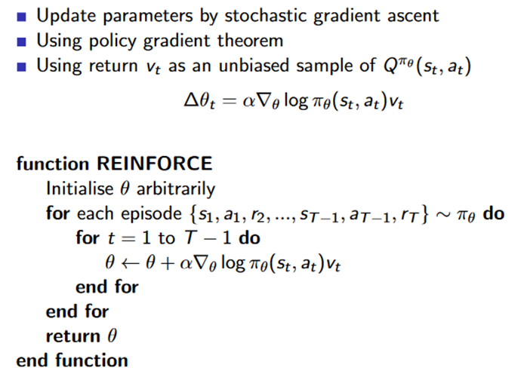
REINFORCE (Monte-Carlo Policy Gradient)
From David Silver's slides

Slide 34

Updating the Policy: Gradient Ascent
We first show the update rule for a One-Step MDP. Probability of starting at state s, is given by p(s).
Problematic!
Now, we can just sample an initial state and sample an action according to the policy!
Notes:
Problematic, need to know what will happen on actions we didn't take – or always act uniformly and not according to policy (which is a very bad idea, because we won't be able to learn anything beyond the first few moves)…
Central limit theorem (law of large numbers): the average of the results obtained from a large number of trials should be close to the expected value, and will tend to become closer as more trials are performed.

Slide 35
Policy Gradient Theorem
For a general MDP, all we need to do is replace r with the Q value (according to the policy).

Slide 36
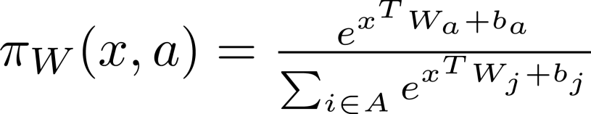
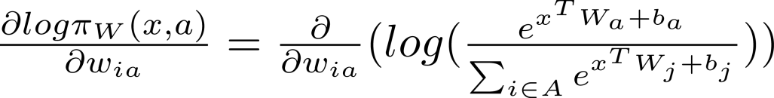
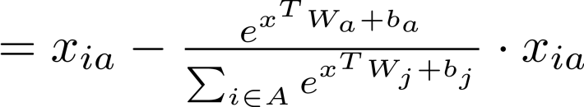

Score of Softmax
Notes:
I hope that I got this right… I couldn't find any reference

Slide 37
Actor-Critic
Actor-critic is an on-policy RL method that tries to learn the best policy directly (policy-based), but also learns the value of each state (so it is also value-based).
The actor has a policy that it follows.
The critic, estimates the value of every state and provides a "critic" to actor, so that the actor can update its policy (using gradient ascent).
The critic updates the value of the old state according to the action taken by the actor.

Slide 38
Actor-Critic vs REINFORCE
Actor-Critic runs only on a single step, while REINFORCE needs a full episode.
Update Rule:
REINFORCE uses the return:
Actor-Critic uses an estimate for Q:
Actor-Critic requires an estimate for Q (just as we have done for e-greedy).

Slide 39
Gradients in Tensorflow
As usual, Tensorflow will compute the gradients for us, so all we need to define is our loss function.
REINFORCE:
Actor-Critic:
Ɵ's are the variables (W's are fixed)
W's are the variables (Ɵ's are fixed)
a' is the actual next action (on-policy)

Slide 40
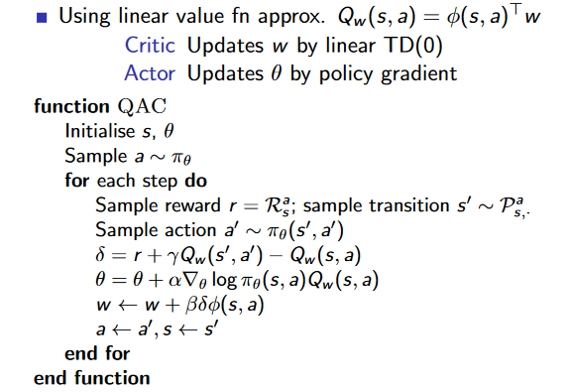
Actor-Critic Algorithm
From David Silver's slides

Slide 41
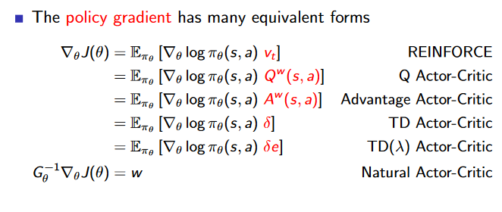
Additional improvements on Actor-Critic
From David Silver's slides
Notes:
Only here for compleness

